Slide 1
Introduction to structured VLSI Projects 4 and 5
Steffen Malkowsky
steffen.malkowsky@eit.lth.se
Jesús Rodríguez
jesus.rodriguez@eit.lth.se

Slide 2
Objectives
Understand how to use the IP generator
Designing an interface with a memory and system integration
Fixed point programming and algorithm development from Matlab to Hardware implementation
Optimizing design for hardware resource constraints

Slide 3
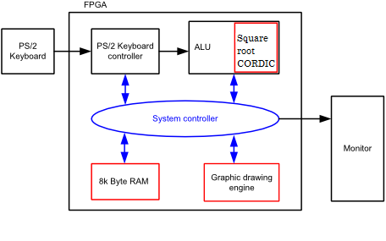
Overview of the system
GRADE 5
GRADE 4

Slide 4
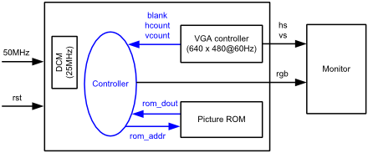
VGA controller

Slide 5
VGA controller
Understand the VGA controller design.
Modify parts of it to control the VGA display
Create a driver for one 7 segment number display and re-use it to create others
Remember that the square root will need an additional 7 segment displays

Slide 6
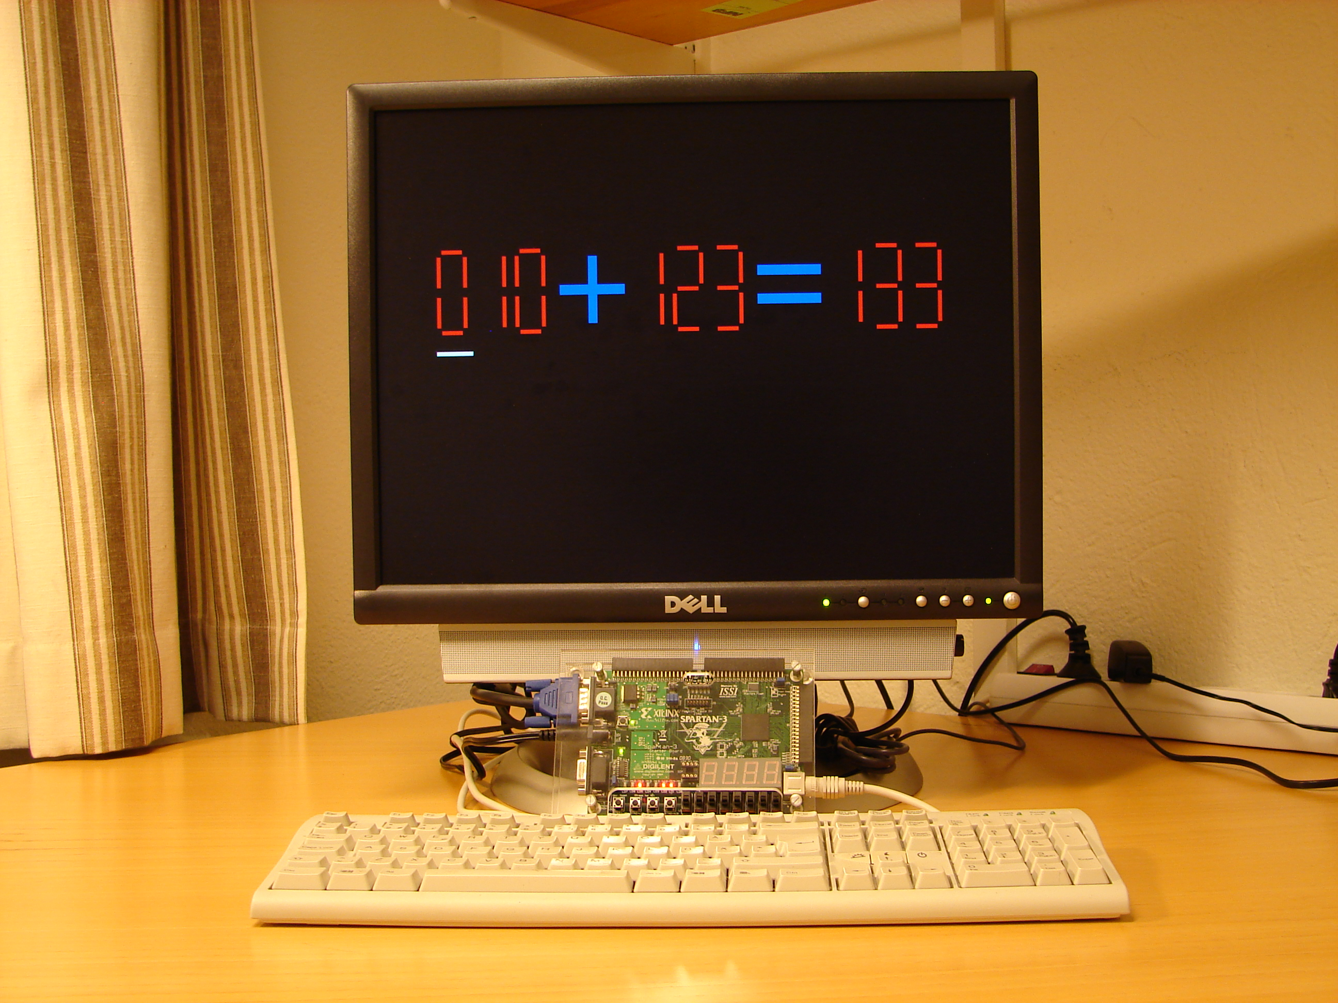
VGA controller

Slide 7
Project 4 - Calculator with Memory Objectives:
Integrate a 8k bit, 8bit wide RAM module to your ALU
Create/Update the VGA controller to display inputs and outputs on VGA screen
Input operands and operator from keyboard, store in RAM, fetch data and display results on VGA screen
Input operands are unsigned in the range of 0 to 255, but the result will be signed

Slide 8
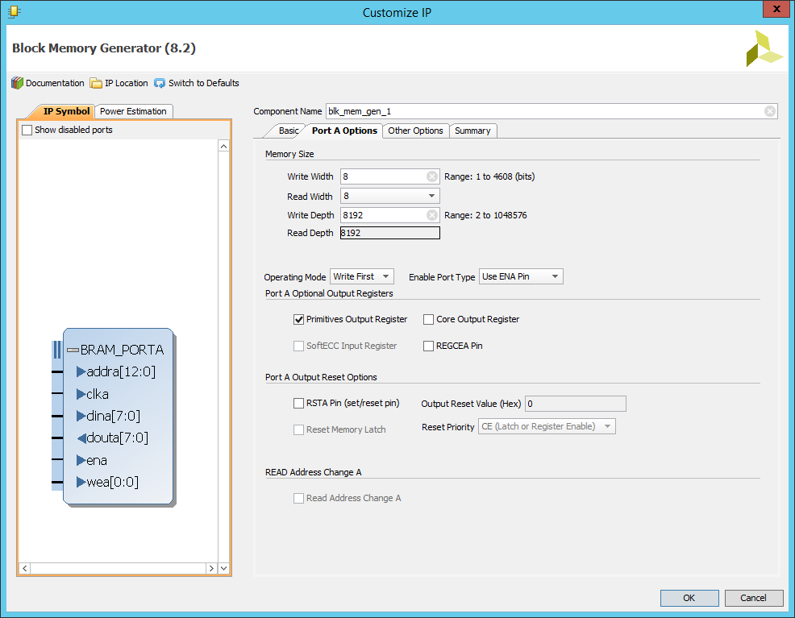
Xilinx LogiCoreIP generator
Read about the IP generator
Instantiate the memory following instructions from the manual

Slide 9
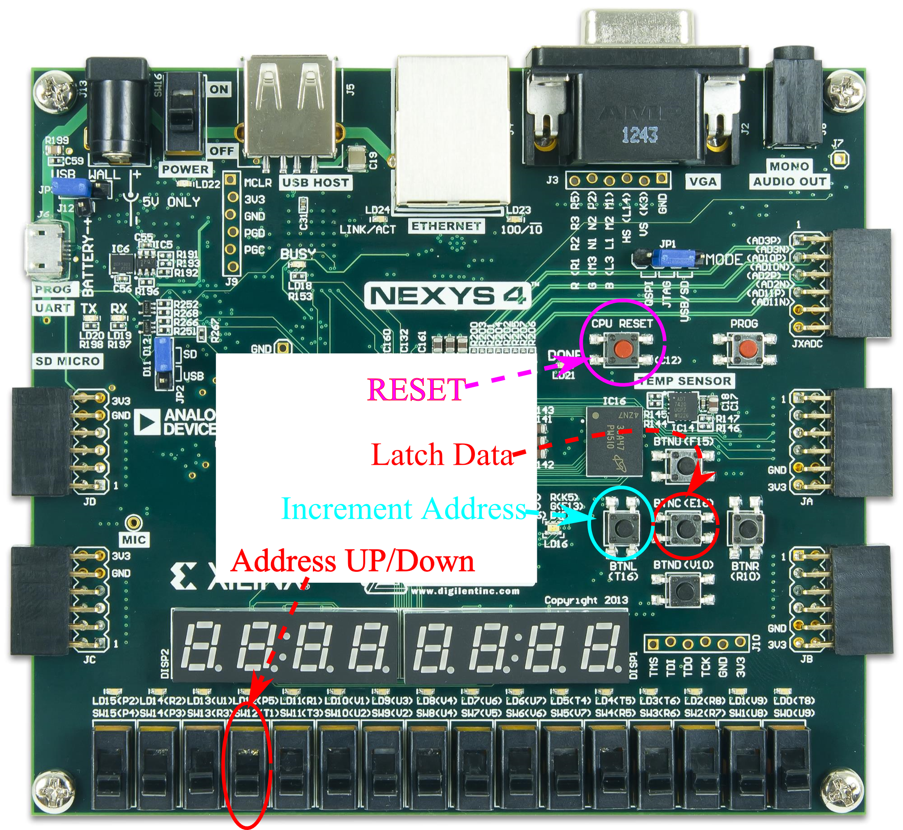
Testing the RAM

Slide 10
Expected operation : Data fill
Enter data from keyboard
Press data latch button
6
Addr 8
-
Addr 7
30
Addr 6
3
Addr 5
*
Addr 4
54
Addr 3
Direction of data fill
98
Addr 2
+
Addr 1
10
Addr 0

Slide 11
Expected operation : Data retrieve and display
At every press of the <Enter> key
Pop data
Display result
6
Addr 8
-
Addr 7
VGA SCREEN
30
Addr 6
Direction of data POP
3
Addr 5
*
Addr 4
003 * 054 = +162
006 – 030 = -024
54
Addr 3
98
Addr 2
+
Addr 1
10
Addr 0

Slide 12
Expected operation: Enter more operands
Should be able to accept new inputs
In the middle of data display
Enter operands from keyboard
Press latch data
The next display on pressing the <Enter> key should be 007*007 = +049
VGA SCREEN
7
Addr 5
*
Addr 4
7
Addr 3
003 * 054 = +162
007 * 007 = +049
98
Addr 2
+
Addr 1
10
Addr 0

Slide 13
Expected operation :

Slide 14
Project 5: ALU with square root and CORDIC

Slide 15
Objectives
Develop an algorithm for square root and cordic
Implement in Matlab and verify with RTL output
Display result accurate to atleast 3 decimal digits
Sqrt(111) = 10.535
Sqrt(121) = 11.000
Do not use a look up table!!
The final implementation should be within a specified hardware resource utilization constraint. (More details in the manual)

Slide 16
Square root unit
Different algorithms available to compute the square root
Use Google, Wikipedia to find algorithms
Iterative algorithm
Needs a simple state machine
Make sure the decimal point is moved properly between states
Some of the algorithms need a division operation
Use an IP to generate division outputs
Contact the TA before you finalize your algorithm

Slide 17
Hardware utilization
Multipliers and dividers are usually needed for iterative algorithms
Re-use as many as possible
Synthesize sqrt unit separately to enable the TA’s to check that you have met the resource constraints

Slide 18
Divider
Use the LogiCore IP generator to generate a divider
Discuss with TA about your choices of internal signal widths before starting
3 digits in decimal corresponds to 10 bits in binary
Test the divider unit separately before integrating

Slide 19
Integration
Integrate the square root and CORDIC into the ALU unit
Final implementation should be able to accept square root as one of the operands (Use the key of your choice to indicate square root) and store it in the memory
Should display the results when enter keys are pressed just like in Project 4.

